Slide 1

Saving Reddit
Kush Patel | Amisha Aggarwal | Raj Thakkar | Sai Kiran Reddy | Gaurav Borad

Slide 2

Background
Posts regarding Suicidality
500 anonymized posts from Reddit users with labels
Dataset helps identify those at highest risk for self-harm or suicide
Proper data analysis can help with saving lives!
Notes:
Add
Data cleaning
Data types

Slide 3

Data Exploration

Slide 4

Data Info
Steps
Data Importation (SAS)
Initial Observation
Clean Data
https://www.kaggle.com/datasets/thedevastator/c-ssrs-labeled-suicidality-in-500-anonymized-red
Notes:
Add
Data cleaning
Data types

Slide 5
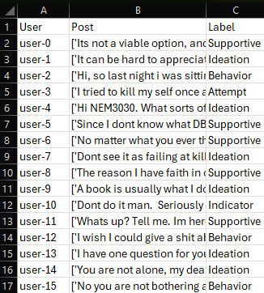
Data Info (The Data Set)
User | Post | Label
Unique identifier (ID) for each user / post | Text written within the reddit post (Text) | Assigned label for the post (Target)
Categorical Labels:
Each message is associated with a label and can falling five categories (Supportive, Attempt, Ideation, Indicator, Behavior)
These labels are categorical and used to classify the content into relevant categories.
Notes:
Add
Data cleaning
Data types
the user IDs serve as identifiers with no numerical or ordinal meaning, meaning they are nominal data.
After cleaning, the dataset became well-structured with clear text content and meaningful labels, ready for text mining models to identify patterns in suicide-related behavior.\\

Slide 6
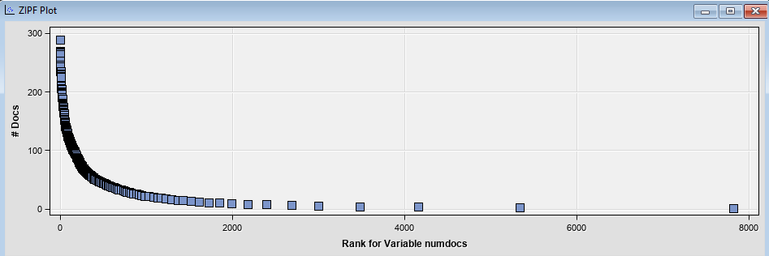
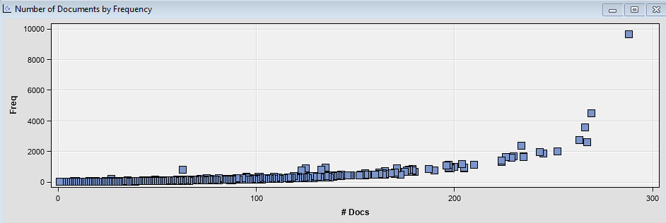
Data Set Analysis (ZIPF & Doc Freq.)

Slide 7
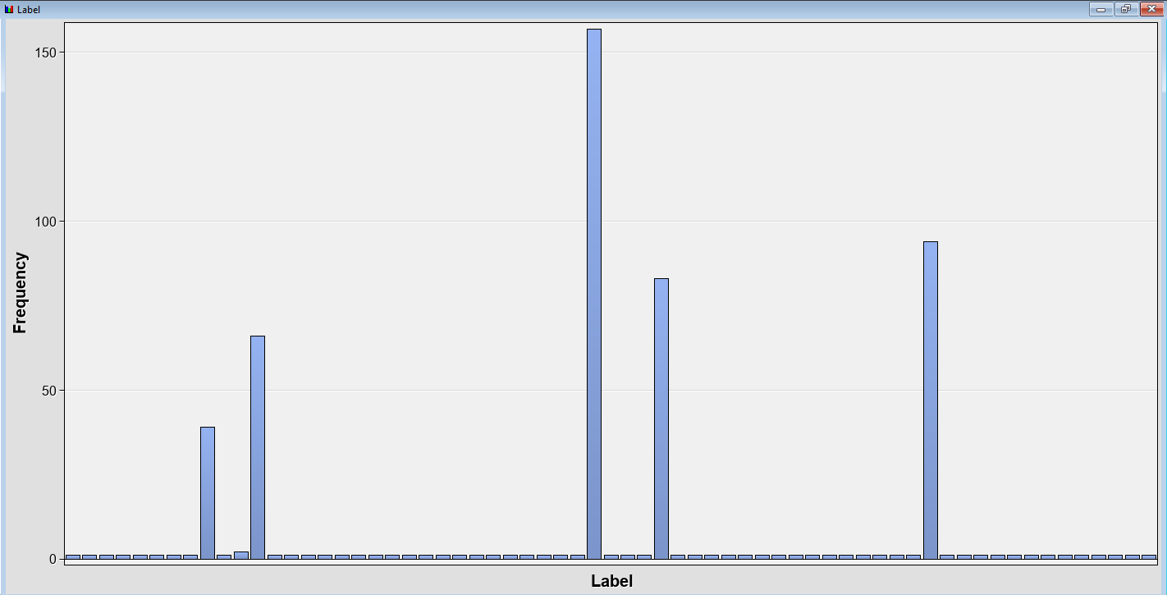
Data Set Analysis (Distribution)

Slide 8
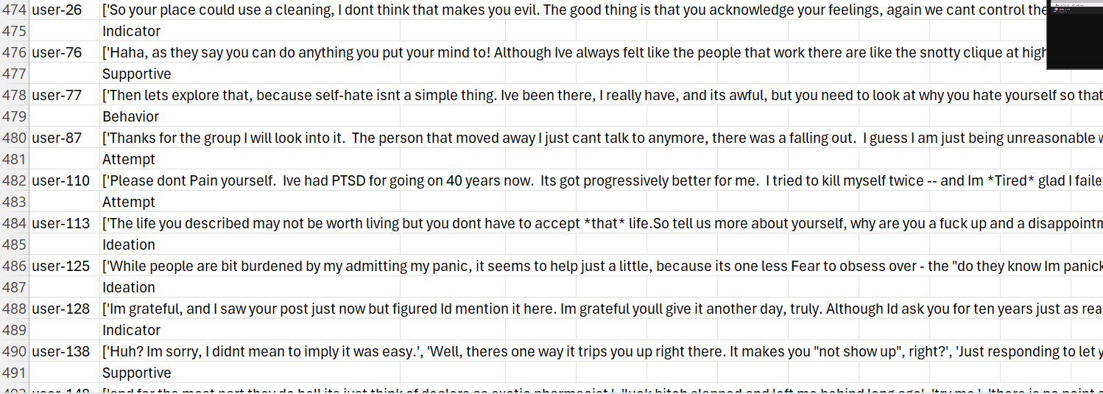
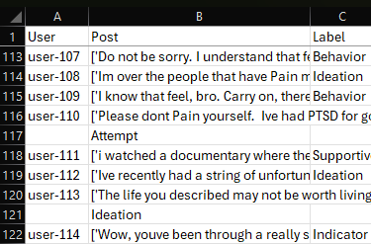
Cleaning of Data
This structural inconsistency complicates the analysis, as both the label and the message are intertwined rather than clearly segmented.
Notes:
Add
Data cleaning
Data types
This slide shows the unprocessed text data collected from user conversations.
Labels like "Supportive," "Behavior," and "Indicator" are mixed with critical labels such as "Attempt" and "Ideation," diluting the dataset’s focus.

Slide 9
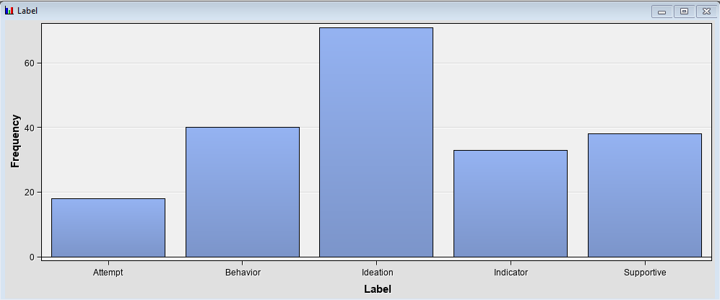
Cleaning of Data

Slide 10
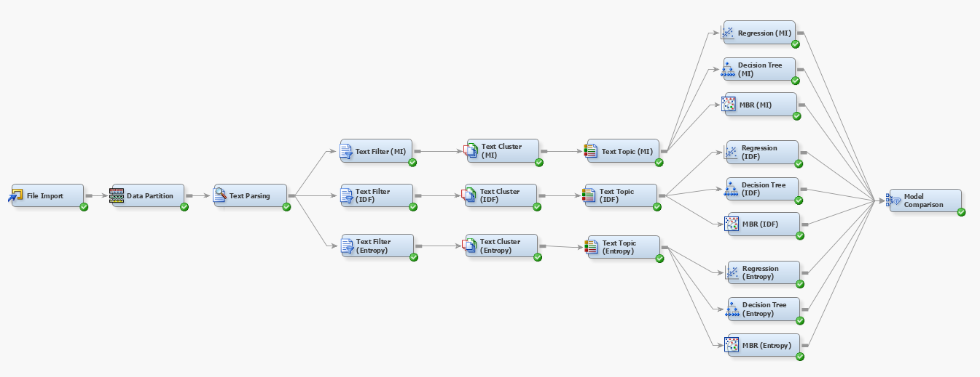
Building Diagram
40
30
30
Min # of Docs: 100
High
100
Exact
5

Slide 11
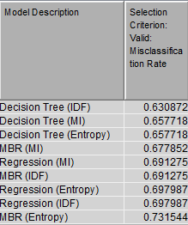
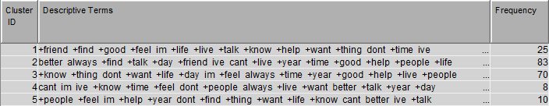
Initial results
Best Model
Decision Tree (IDF)
Misclassification Rate
0.63 = 63%
Accuracy
0.37 = 37%

Slide 12

Refining

Slide 13
Adjustments
Original Data
Classifications
Combined Classifications
Attempt
Attempt
Behavior
Indicator
Final Data Set
Ideation
Ideation
Supportive
Supportive

Slide 14

Experimenting

Slide 15


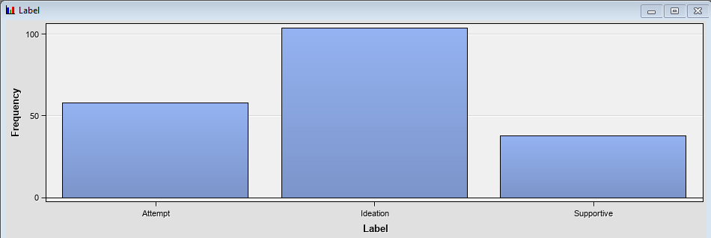
File import
Editing Variables
Variable Distribution

Slide 16


Data Partition
Partitioning the data
Small data = small allocations for test and validation datasets

Slide 17
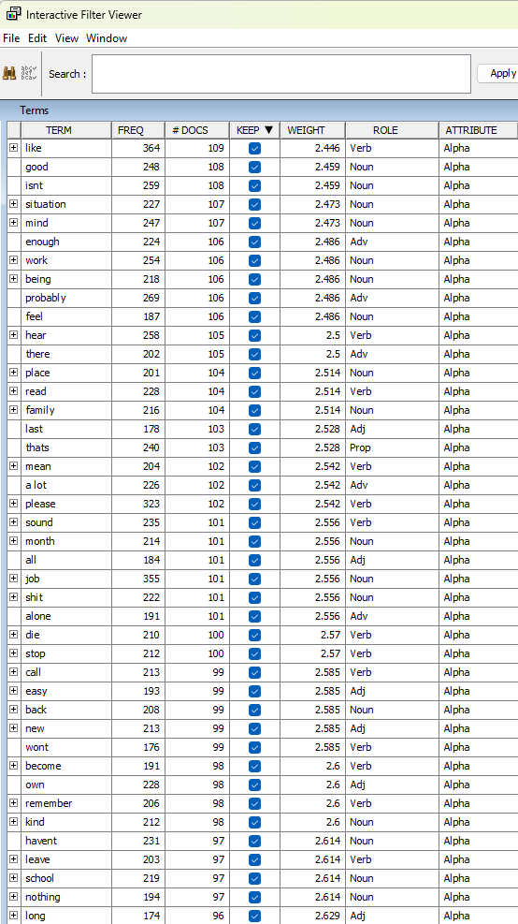


Text Filtering
Frequency
Keep or Delete?

Slide 18
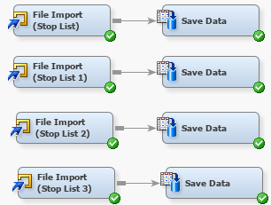
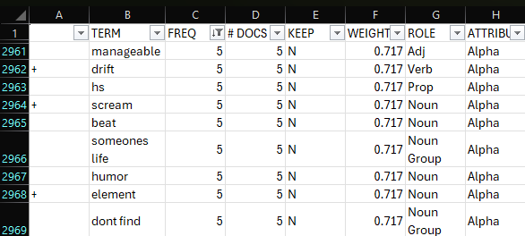
Text Parsing - Stop List
Multiple stop lists
Derived from existing stop list based on filter viewer and our knowledge of the dataset
Multiple diagram variations to check which stop list worked the best

Slide 19

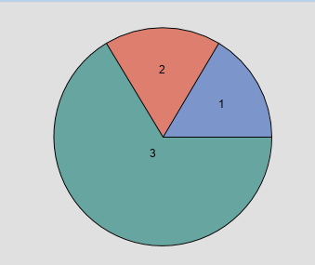
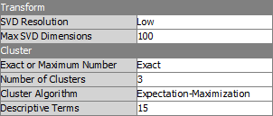
Text clustering
Resolution
Dimension
Number of Clusters

Slide 20

Model Creation

Slide 21
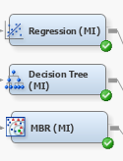
Mutual Information (MI)
Frequency Weighting
Log
Term Weight
Mutual Information
Models
Regression
Decision Tree
Memory Based Reasoning

Slide 22
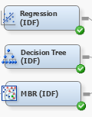
Inverse Document Frequency (IDF)
Frequency Weighting
Log
Term Weight
Inverse Document Frequency
Models
Regression
Decision Tree (25 leafs)
Memory Based Reasoning

Slide 23
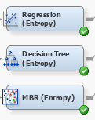
Entropy
Frequency Weighting
Log
Term Weight
Entropy
Models
Regression
Decision Tree
Memory Based Reasoning

Slide 24
Model Comparison

Slide 25
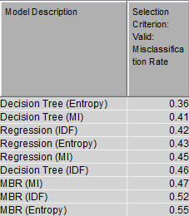
Comparison
Best Model
Decision Tree (Entropy)
Misclassification Rate
0.36 = 36%
Accuracy
0.64 = 64%

Slide 26

So Why
Low Accuracy

Slide 27
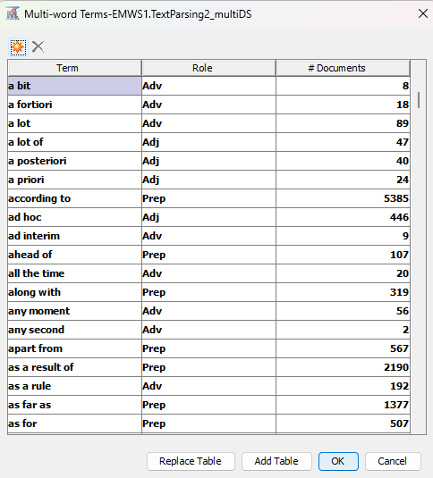
Final Thoughts
Future Improvements
Custom Multi-word Terms
Possibility more defined Stop List
More data

Slide 28
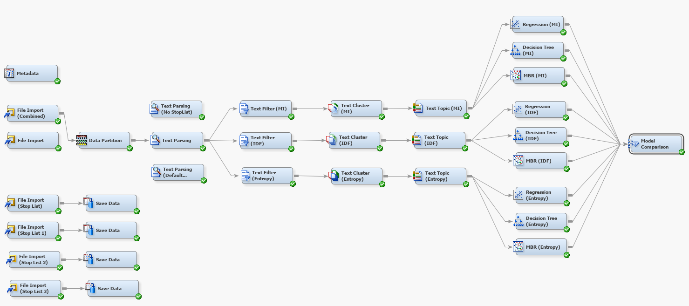
Final Diagram

Slide 29

Thank you!
Questions?

